Slide 1
Project title: Interactive Recipe Finder
CAPSTONE PROJECT
Presented By:
student name: Binnala Hemanth
College name: Aditya Institute of Technology and Management
Department :Computer Science Engineering Specializing in Data Science

Slide 2
OUTLINE
Problem Statement
System Development Approach
Algorithm & Deployment
Result
Conclusion
Future Scope
References

Slide 3
Problem Statement: The Challenge of Modern Recipe Discovery and Meal Planning
Home cooks face significant frustration and inefficiency when planning meals due to the inability of
current recipe platforms to dynamically account for on-hand ingredients, specific dietary constraints,
and limited cooking time.
Ingredient Waste: Cooks often abandon recipes or make time-consuming grocery trips
because they cannot easily find meals that utilize their existing pantry inventory.
Lack of Personalization: Existing search filters are often rigid and slow, failing to provide instant
customized suggestions that blend multiple
criteria (e.g., "Gluten-Free," "Under 30 Minutes," and "Use Chicken Thighs").
Decision Fatigue: The sheer volume of static search results leads to overwhelm and
unnecessary time spent sifting through irrelevant options instead of actively cooking.

Slide 4
System Approach Technology Stack & Design Principles
Core Frontend Technologies
HTML5: Serves as the foundational structure and semantic organization of the web application.
CSS3: Utilized for all styling, visual aesthetics, and implementing responsive layouts across all devices.
JavaScript (ES6+): Enables dynamic interactivity for key user functions, including
product filtering, shopping cart management, and real-time total calculations.
II. Design
User Interface (UI): Focused on a clean, intuitive, and user-friendly interface to maximize ease of use.
Mobile-First Design: Ensures the application is fully mobile-responsive,
providing an optimal viewing and interaction experience on smartphones and tablets.
Modular Separation: Adheres to best practices by maintaining distinct, separate files
for HTML (structure), CSS (style), and JavaScript (logic) for cleaner code and easier maintenance.

Slide 5
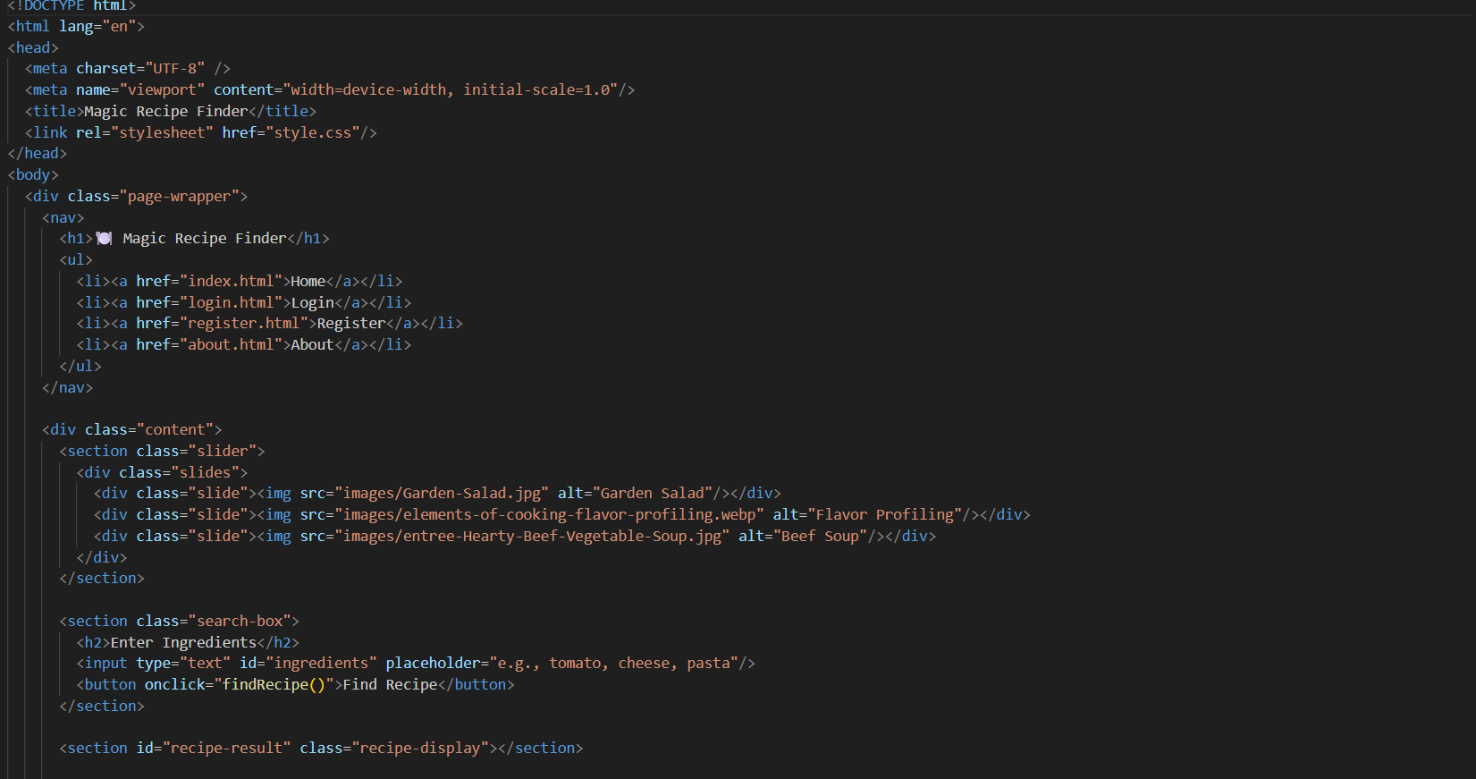
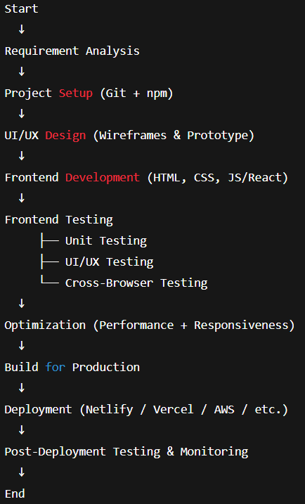
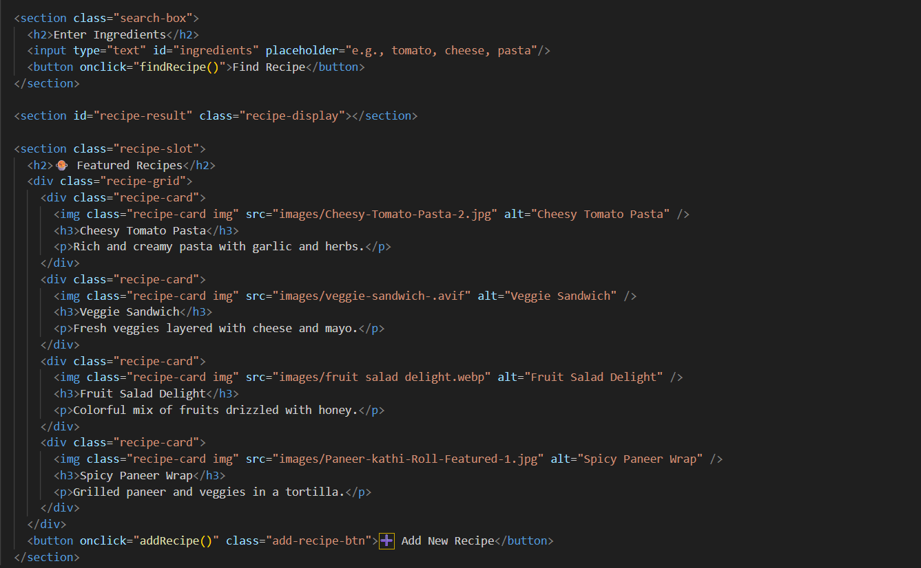
Problem Statement:
Algorithm and Deployment

Slide 6
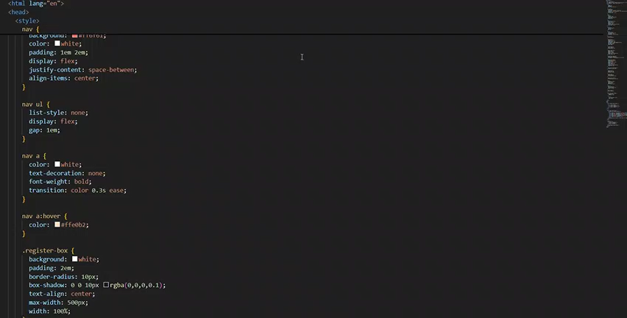
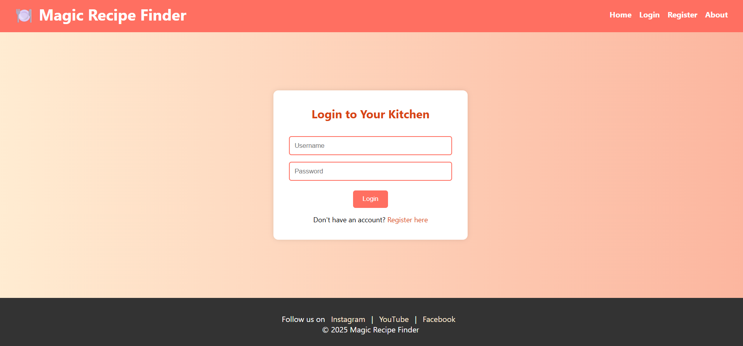
Result
Git hub link: https://hemanthbinnala.github.io/Recipe-finder/

Slide 7
Conclusion
The Problem Solved
The complexity and cost of traditional e-commerce solutions currently prevent small
businesses from establishing effective online product displays.
The Solution's Impact
Empowerment: We deliver a lightweight, visually appealing, and
cost-effective platform that instantly empowers small businesses to showcase their products digitally.
Customer Experience: The use of JavaScript-driven interactivity
filtering, real-time cart) ensures a modern, user-friendly, and engaging customer browsing experience.
Final Takeaway
By focusing on simplicity, modularity, and essential frontend technologies, our solution bridges
the digital gap, allowing small businesses to compete effectively online without the burden of complexity or high fees.

Slide 8
Future scope(Optional)
Persistent Data Storage: Implement local storage (Browser-based) or a simple,
free Backend-as-a-Service (BaaS) like Firebase or Supabase to save cart data and product updates permanently.
Simple Authentication: Introduce basic user sign-in/sign-up, enabling features
like saving Wishlist's and tracking order history (if an order process is added).
Advanced Filtering: Extend product filtering beyond category to include Price Range sliders
and Multi-select attribute filters (e.g., color, size, material).

Slide 9
References
Reference-1
Mozilla Developer Network (MDN) Web Docs
NanthiniMoha/TNSDC-FWD-DIGITAL_PORTFOLIO
Get started with Bootstrap · Bootstrap v5.3

Slide 10
THANK YOU

